Slide 1
Lecture 25: Searching and Sorting
Building Java Programs: A Back to Basics Approach
by Stuart Reges and Marty Stepp
Copyright (c) Pearson 2013.
All rights reserved.

Slide 2
Sequential search
sequential search: Locates a target value in an array/list by examining each element from start to finish.
  How many elements will it need to examine?
  Example: Searching the array below for the value 42:
  Notice that the array is sorted. Could we take advantage of this?
index | 0 | 1 | 2 | 3 | 4 | 5 | 6 | 7 | 8 | 9 | 10 | 11 | 12 | 13 | 14 | 15 | 16
value | -4 | 2 | 7 | 10 | 15 | 20 | 22 | 25 | 30 | 36 | 42 | 50 | 56 | 68 | 85 | 92 | 103
i

Slide 3
Binary search (13.1)
binary search: Locates a target value in a sorted array/list by successively eliminating half of the array from consideration.
  How many elements will it need to examine?
  Example: Searching the array below for the value 42:
index | 0 | 1 | 2 | 3 | 4 | 5 | 6 | 7 | 8 | 9 | 10 | 11 | 12 | 13 | 14 | 15 | 16
value | -4 | 2 | 7 | 10 | 15 | 20 | 22 | 25 | 30 | 36 | 42 | 50 | 56 | 68 | 85 | 92 | 103
min
mid
max

Slide 4
The Arrays class
Class Arrays in java.util has many useful array methods:
Method name | Description
binarySearch(array, value) | returns the index of the given value in a sorted array (or < 0 if not found)
copyOfRange(array, index1, index2) | returns a new resized copy of an array starting with index1 to index2-1
equals(array1, array2) | returns true if the two arrays contain same elements in the same order
fill(array, value) | sets every element to the given value
sort(array) | arranges the elements into sorted order
toString(array) | returns a string representing the array, such as "[10, 30, -25, 17]"

Slide 5
Using binarySearch
// index 0 1 2 3 4 5 6 7 8 9 10 11 12 13 14 15
int[] a = {-4, 2, 7, 9, 15, 19, 25, 28, 30, 36, 42, 50, 56, 68, 85, 92};
int index = Arrays.binarySearch(a, 42); // index1 is 10
int index2 = Arrays.binarySearch(a, 21); // index2 is -7
binarySearch returns the index where the value is found
if the value is not found, binarySearch returns:
  -(insertionPoint + 1)
  where insertionPoint is the index where the element would have been, if it had been in the array in sorted order.
  To insert the value into the array, negate (returnedValue + 1)
  int indexToInsert21 = -(index2 + 1); // 6

Slide 6
Recursive binary search (13.3)
Write a recursive binarySearch method.
  If the target value is not found, return its negative insertion point.
  int index = binarySearch(data, 42); // 10
  int index2 = binarySearch(data, 66); // -1
  Note: Recursive version does not return
  -(insertionPoint+1).
index | 0 | 1 | 2 | 3 | 4 | 5 | 6 | 7 | 8 | 9 | 10 | 11 | 12 | 13 | 14 | 15 | 16
value | -4 | 2 | 7 | 10 | 15 | 20 | 22 | 25 | 30 | 36 | 42 | 50 | 56 | 68 | 85 | 92 | 103

Slide 7
Exercise solution
  // Returns the index of an occurrence of the given value in
  // the given array, or a negative number if not found.
  // Precondition: elements of a are in sorted order
  public static int binarySearch(int[] a, int target) {
  return binarySearch(a, target, 0, a.length - 1);
  }
  // Recursive helper to implement search behavior.
  private static int binarySearch(int[] a, int target,
  int min, int max) {
  if (min > max) {
  return -1; // target not found
  } else {
  int mid = (min + max) / 2;
  if (a[mid] < target) { // too small; go right
  return binarySearch(a, target, mid + 1, max);
  } else if (a[mid] > target) { // too large; go left
  return binarySearch(a, target, min, mid - 1);
  } else {
  return mid; // target found; a[mid] == target
  }
  }
  }

Slide 8
Searching/Sorting in Java
The Arrays and Collections classes in java.util have a static method sort that sorts the elements of an array/list
  String[] words = {"foo", "bar", "baz", "ball"};
  Arrays.sort(words);
  System.out.println(Arrays.toString(words));
  // [ball, bar, baz, foo]
  int index=Arrays.binarySearch(words, “bar”); // 1

Slide 9
Searching/Sorting in Java
  List<String> words2 = new ArrayList<String>();
  for (String word : words) {
  words2.add(word);
  }
  Collections.sort(words2);
  System.out.println(words2);
  // [ball, bar, baz, foo]

Slide 10
Lab 1
Write the nonrecursive version of binarySearch method.
// Returns the index of an occurrence of target in the
// array a, or a negative number(-(min+1)) if the target
// is not found.
public static int binarySearch(int[] a, int target) {
}

Slide 11
Sorting
sorting: Rearranging the values in an array or collection into a specific order (usually into their "natural ordering").
  one of the fundamental problems in computer science
  can be solved in many ways:
    there are many sorting algorithms
    some are faster/slower than others
    some use more/less memory than others
    some work better with specific kinds of data
    some can utilize multiple computers / processors, ...
  comparison-based sorting : determining order by
  comparing pairs of elements:
    <, >, compareTo, …

Slide 12
Sorting algorithms
bubble sort: swap adjacent pairs that are out of order
selection sort: look for the smallest element, move to front
insertion sort: build an increasingly large sorted front portion
merge sort: recursively divide the array in half and sort it
heap sort: place the values into a sorted tree structure
quick sort: recursively partition array based on a middle value

Slide 13
Sorting algorithms
bubble sort: swap adjacent pairs that are out of order
selection sort: look for the smallest element, move to front
insertion sort: build an increasingly large sorted front portion
merge sort: recursively divide the array in half and sort it
heap sort: place the values into a sorted tree structure
quick sort: recursively partition array based on a middle value

Slide 14
Selection sort
selection sort: Orders a list of values by repeatedly putting the smallest or largest unplaced value into its final position.
  The algorithm:
  Look through the list to find the smallest value.
  Swap it so that it is at index 0.
  Look through the list to find the second-smallest value.
  Swap it so that it is at index 1.
  ...
  Repeat until all values are in their proper places.

Slide 15
Selection sort example
Initial array:
After 1st, 2nd, and 3rd passes:
index | 0 | 1 | 2 | 3 | 4 | 5 | 6 | 7 | 8 | 9 | 10 | 11 | 12 | 13 | 14 | 15 | 16
value | 22 | 18 | 12 | -4 | 27 | 30 | 36 | 50 | 7 | 68 | 91 | 56 | 2 | 85 | 42 | 98 | 25
index | 0 | 1 | 2 | 3 | 4 | 5 | 6 | 7 | 8 | 9 | 10 | 11 | 12 | 13 | 14 | 15 | 16
value | -4 | 18 | 12 | 22 | 27 | 30 | 36 | 50 | 7 | 68 | 91 | 56 | 2 | 85 | 42 | 98 | 25
index | 0 | 1 | 2 | 3 | 4 | 5 | 6 | 7 | 8 | 9 | 10 | 11 | 12 | 13 | 14 | 15 | 16
value | -4 | 2 | 12 | 22 | 27 | 30 | 36 | 50 | 7 | 68 | 91 | 56 | 18 | 85 | 42 | 98 | 25
index | 0 | 1 | 2 | 3 | 4 | 5 | 6 | 7 | 8 | 9 | 10 | 11 | 12 | 13 | 14 | 15 | 16
value | -4 | 2 | 7 | 22 | 27 | 30 | 36 | 50 | 12 | 68 | 91 | 56 | 18 | 85 | 42 | 98 | 25

Slide 16
Insertion Sort
insertion sort: Shift each element into a sorted sub-array
  faster than selection sort (examines fewer values)
index | 0 | 1 | 2 | 3 | 4 | 5 | 6 | 7 | 8 | 9 | 10 | 11 | 12 | 13 | 14 | 15 | 16
value | -4 | 12 | 18 | 22 | 27 | 30 | 36 | 50 | 7 | 68 | 91 | 56 | 2 | 85 | 42 | 98 | 25
sorted sub-array (indexes 0-7)
7
Notes:
A lot of 143 students implement a kind of insertion sort on their SortedIntList add operation.

Slide 17
Insertion Sort Algorithm
Check element.
If larger than the previous element, leave it.
If smaller than the previous element, shift previous larger elements down until you reach a smaller element (or beginning of array).
Insert element.

Slide 18

Insertion Sort Algorithm
64 54 18 87 35
  54 less than 64
  Shift down and insert 54
54 64 18 87 35(1st pass)
  18 less than 64
  18 less than 54
  Shift down and insert 18
18 54 64 87 35(2nd pass)
  87 greater than 64
  Go to next element
18 54 64 87 35(3rd pass)
  35 less than 87
  35 less than 64
  35 less than 54
  35 greater than 18
  Shift down and insert 35
18 35 54 64 87(4th pass)

Slide 19
Merge sort
merge sort: Repeatedly divides the data in half, sorts each half, and combines the sorted halves into a sorted whole.
  The algorithm:
  Divide the list into two roughly equal halves.
  Sort the left half.
  Sort the right half.
  Merge the two sorted halves into one sorted list.
  Often implemented recursively.
  An example of a "divide and conquer" algorithm.
    Invented by John von Neumann in 1945

Slide 20
Merge sort example
index | 0 | 1 | 2 | 3 | 4 | 5 | 6 | 7
value | 22 | 18 | 12 | -4 | 58 | 7 | 31 | 42
split
22 | 18 | 12 | -4
58 | 7 | 31 | 42
split
split
22 | 18
12 | -4
58 | 7
31 | 42
split
split
split
split
22
18
12
-4
58
7
31
42
merge
merge
merge
merge
18 | 22
-4 | 12
7 | 58
31 | 42
merge
merge
-4 | 12 | 18 | 22
7 | 31 | 42 | 58
merge
-4 | 7 | 12 | 18 | 22 | 31 | 42 | 58

Slide 21
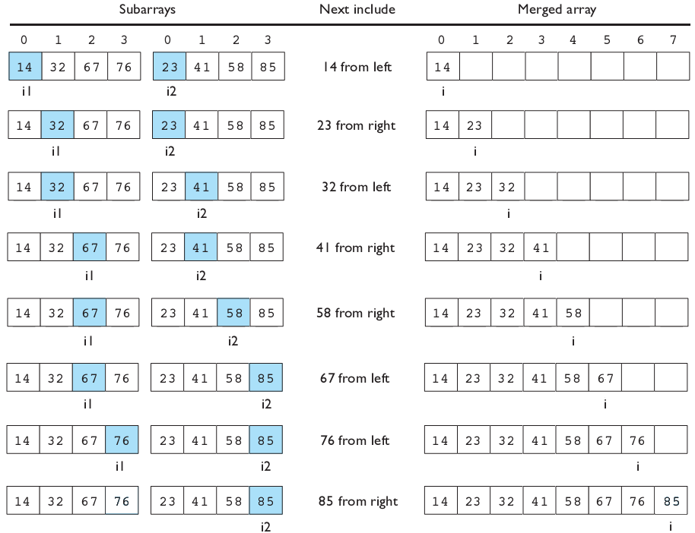
Merging sorted halves

Slide 22
Merge halves code
// Merges the left/right elements into a sorted result.
// Precondition: left/right are sorted
public static void merge(int[] result, int[] left,
int[] right) {
int i1 = 0; // index into left array
int i2 = 0; // index into right array
for (int i = 0; i < result.length; i++) {
if (i2 >= right.length ||
(i1 < left.length && left[i1] <= right[i2])) {
result[i] = left[i1]; // take from left
i1++;
} else {
result[i] = right[i2]; // take from right
i2++;
}
}
}

Slide 23
Merge sort code
// Rearranges the elements of a into sorted order using
// the merge sort algorithm (recursive).
public static void mergeSort(int[] a) {
if (a.length >= 2) {
// split array into two halves
int[] left = Arrays.copyOfRange(a, 0, a.length/2);
int[] right = Arrays.copyOfRange(a, a.length/2, a.length);
// sort the two halves
mergeSort(left);
mergeSort(right);
// merge the sorted halves into a sorted whole
merge(a, left, right);
}
}

Slide 24
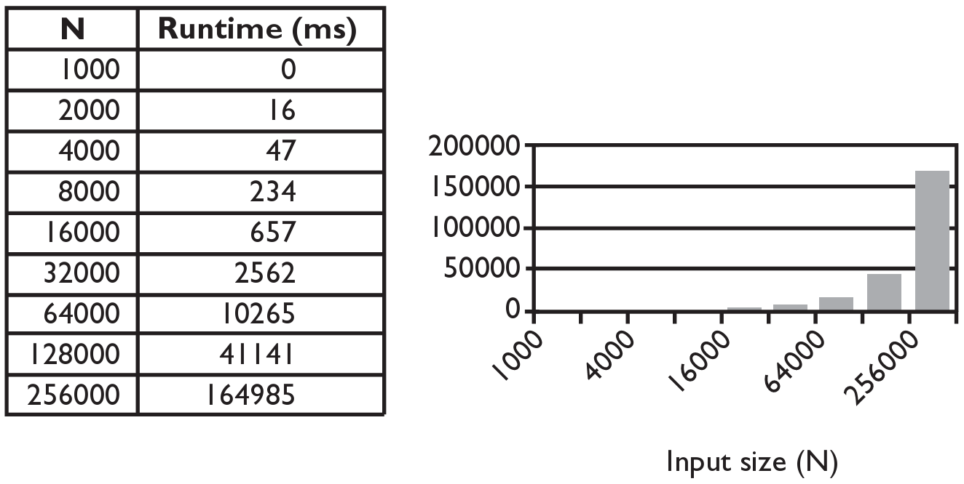
Selection sort runtime (Fig. 13.6)
What is the complexity class (Big-Oh) of selection sort?

Slide 25
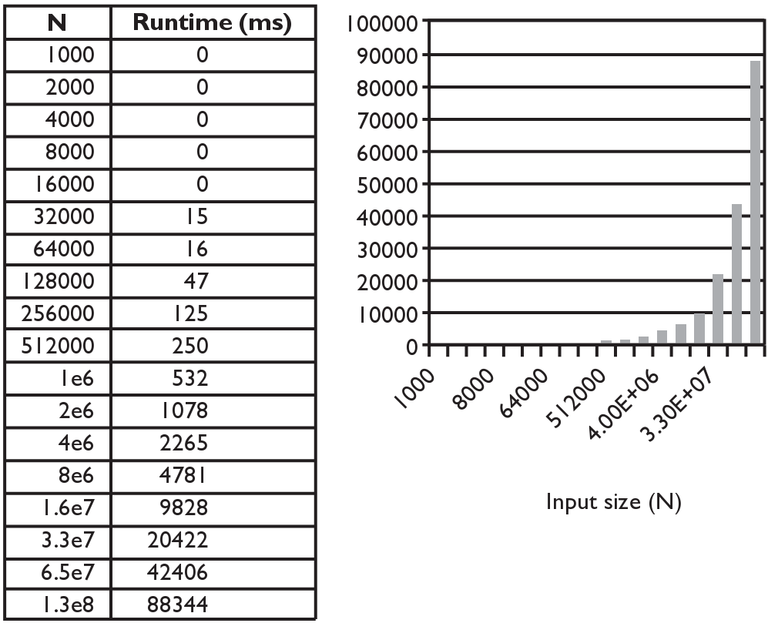
Merge sort runtime
What is the complexity class (Big-Oh) of merge sort?

Slide 26
Lab 2
Write the methods selectionSort and swap.
public static void selectionSort(int[] a)
{…}
public static void swap(int[] a, int i, int j)
{…}

